Slide 1
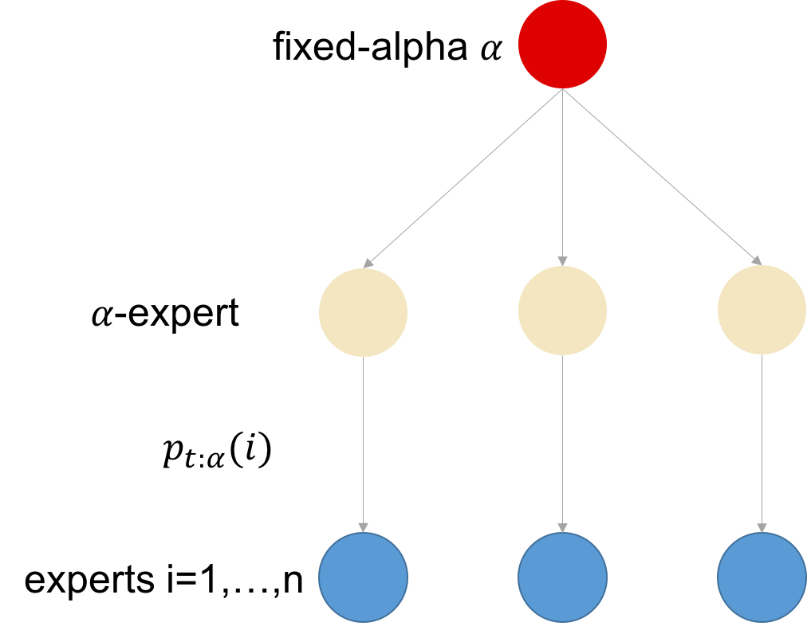
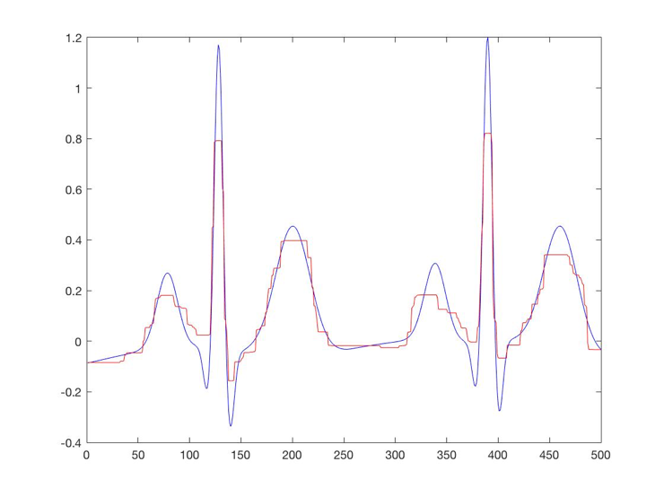
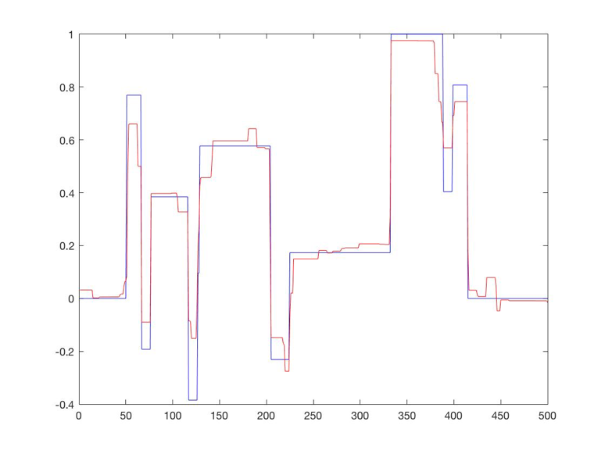
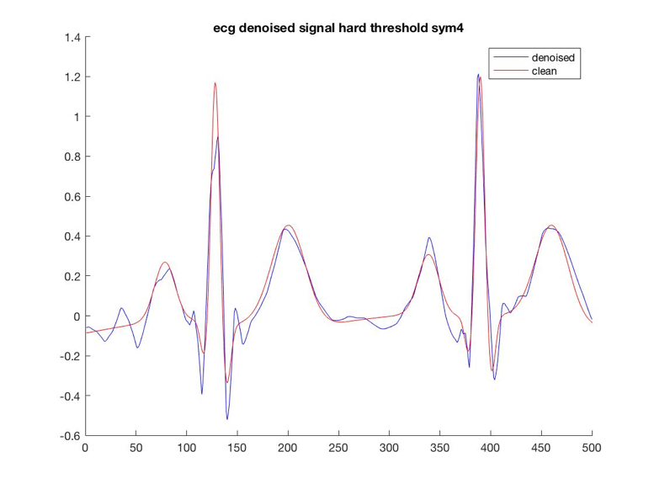
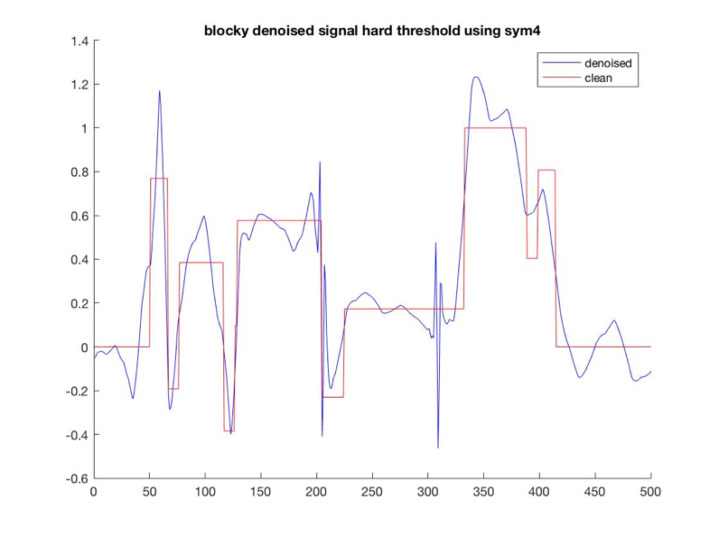
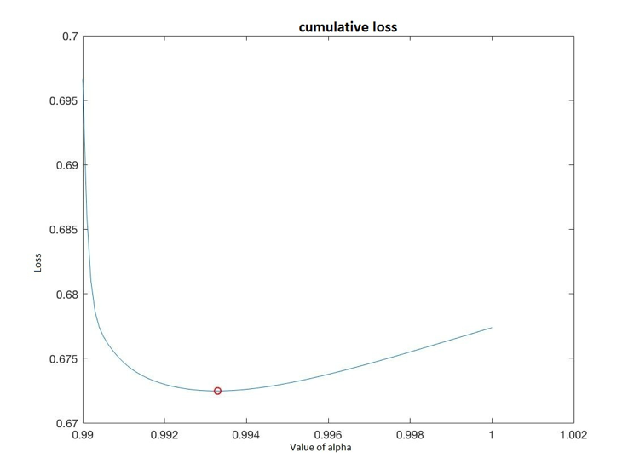
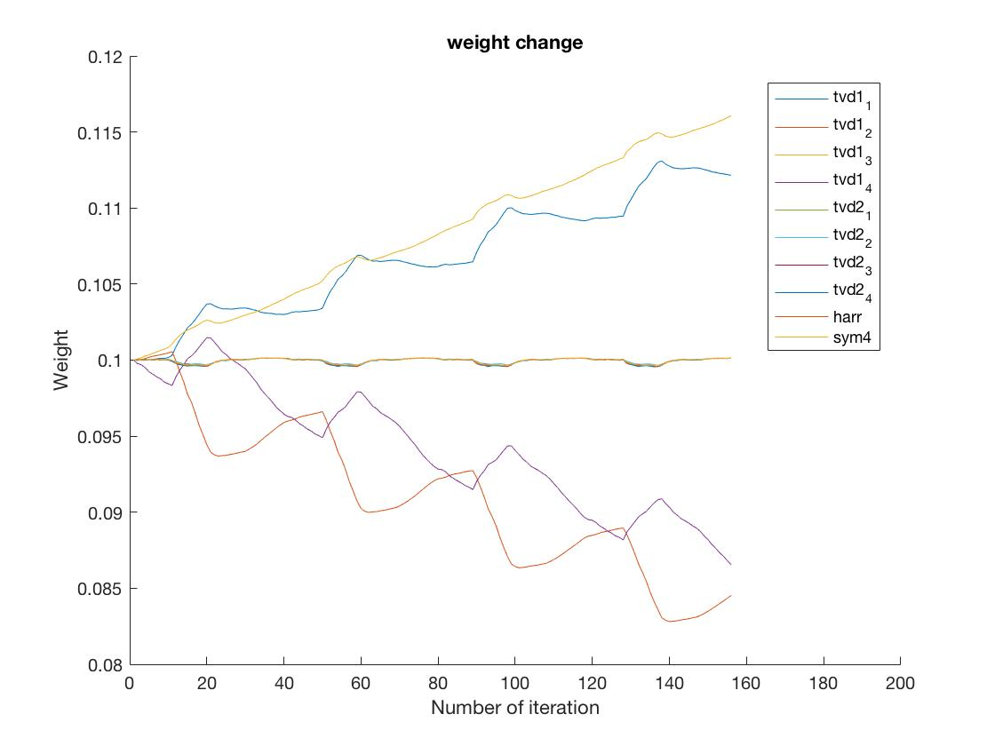
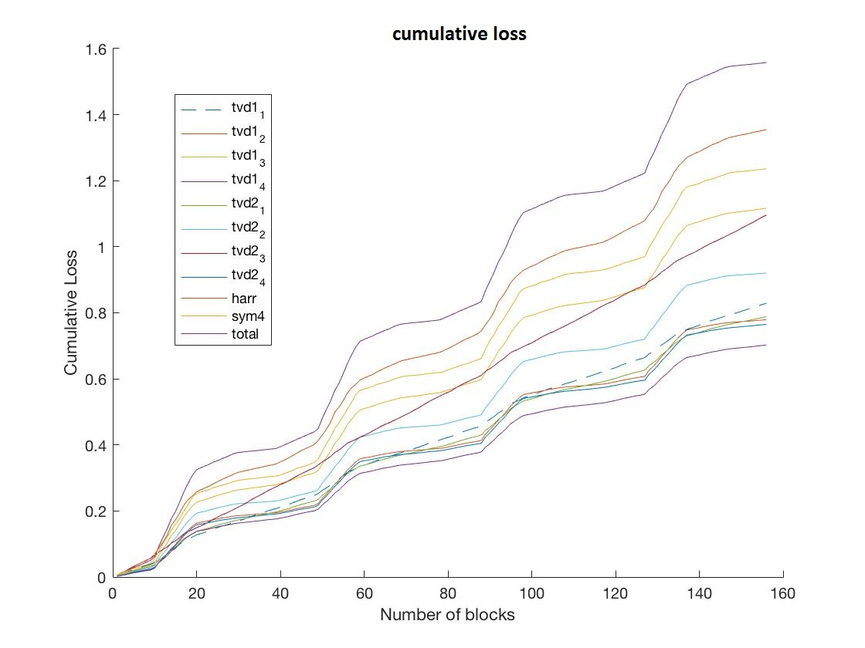

Expert Advice In Signal Denoising
Ce Fang, Fangfang Sun, Junlin Liu, Lin Qi, Tianpei Cai | Prof. Choromanka |NYU
Problem / Question
Fixed-alpha model
Expert denoised result
Signal denoising is to filter out the noise, and the challenge is how to preserve the important feature during the denoising process. Here we want to reconstruct the signal from blurred and noised signal.
Tvd1_1 for blocky and non-blocky signal
Hypothesis
Assuming the distribution of noise is changing continuously(mean and covariance).
Assuming we only have two kinds of clean signal(blocky and non-blocky).
Our algorithm should predict the best denoised signal with least loss.
$$p_{t;α}\left(i\right)=\frac{1}{Z_{t}}\sum_{j=1}^{k}{p_{t−1}\left(j;α\right)∗}e^{\left.−ηL_{t−1}(j\right)}∗p\left(i|j;α\right)$$
Finding the best alpha
Sym4 for blocky and non-blocky signal
Project Overview
Generate clean signal with blocky and non blocky part.
Blurring and adding Gaussian white noise to the clean signal.
Adjust the parameters of each expert according to different noise with different distribution.
Looking for different alpha for each expert through some training data.
Pass the noisy signal through the system, and use the weight sum of the output of our experts as the final output.
Compare the cumulative loss of each expert and the final prediction.
Conclusion
From figures above we can see that, our expert advice algorithm can generate the denoised signal with least loss, as it wins with each of this method run by itself.
From the figure we can see the best expert is change with time so our algorithm is able to decrease the current loss when the noisy signal is changing compared to any one of the expert.
Variables / Research
Weight change and total loss
Controlled variables
Expert won’t change their parameters during the prediction.
Independent variable
Input signal is a non stationary sequence.
Dependent variable
Each expert will predict the output according the input signal.
Use the L2 norm of difference between output signal and clean signal as the loss.
Alpha for each expert are fixed.
Signal are read in fixed block size.
Update the weight according to the loss.
References
[1] C. E. Monteleoni, “Online learning of non-stationary sequences,” NIPS, pp. 1093–1100, May 2003.
[2] M. HERBSTER and M. K. WARMUTH, “Tracking the best expert,” Machine Learning, vol. 32, no. 151-178, 1998.
[3] I. Selesnick, “Total variation denoising (an mm algorithm),” 2012, NYU Polytechnic School of Engineering lecture note.
[4] M. U ̈STU ̈NDAG ̆, A. S ̧ENGU ̈R, M. GO ̈KBULUT, and F. ATA, “Performance comparison of wavelet thresholding techniques on weak ecg signal denoising,” PRZEGLAD ELEKTROTECHNICZNY, May 2013.

